Slide 1


Inter-Procedural Data Flow Analysis
Presented by:
AHREN ABISHEK.R (192311034)
CSA1429 Compiler Design: For Industrial AutomationDate: 20/03/2025

Slide 2
Introduction to Data Flow Analysis
Definition & Importance
Data Flow Analysis (DFA) is a technique to track the flow of data within a program.
Helps in compiler optimizations, security analysis, and debugging.
Differentiates between intra-procedural (within a function) and inter-procedural (across multiple functions) analysis.
Need for Inter-Procedural Analysis
Programs are modular – they involve multiple functions.
A single function may affect variables in another function.
Helps in detecting bugs, improving performance, and enforcing security policies.

Slide 3
Existing Models for Data Flow Analysis
. Classic Approaches:
Intraprocedural Analysis (limited to one function).
Static Single Assignment (SSA) (converts variables into unique assignments).
Control Flow Graph (CFG) (represents program execution paths).
Key Methods Used:
Data Flow Equations (models variable changes).
Pointer Analysis (tracks pointer behavior in memory)

Slide 4
Importance & Applications
Why is it important?
Improves code optimization (removes dead code).
Enhances security (detects vulnerabilities).
Assists in parallel computing (identifies dependencies).
Where is it used?
Compilers: GCC, LLVM use it for optimization.
Security Tools: Helps in detecting leaks in apps.
AI & Machine Learning: Used for code analysis in software testing

Slide 5
Challenges in Existing Models
.
Context Insensitivity
Fails to distinguish between different calls of the same function.
Precision vs. Efficiency Tradeoff
Highly precise models are slow; fast models lack accuracy.
Scalability Issues
Works well for small programs but struggles with enterprise-level software

Slide 6
The Proposed Model - Concept & Framework
What is the Proposed Model? A hybrid approach combining static and dynamic analysis.
Uses Graph Neural Networks (GNNs) to improve data flow tracking Hybrid Analysis – Combines Flow-Sensitive, Context-Sensitive, and Graph-Based methods. Function Dependency Tracking – Efficiently maps cross-function data flow and recursion. Alias & Pointer Tracking – Accurately handles memory references and alias analysis. Code Optimization – Detects dead code, redundancies, and inefficiencies. Security Enhancements – Identifies buffer overflows, memory leaks, and vulnerabilities.

Slide 7
System Design / Architecture
Three-Layer Architecture:
Input Processing: Lexical analysis and parsing.
Transformation Engine: Inter-procedural data flow analysis logic.
Output Generation: Reports, warnings, or optimized code.
Flow:
Lexical analysis → Parsing → CFG generation → Data Flow Analysis → Validation → Output generation.

Slide 8
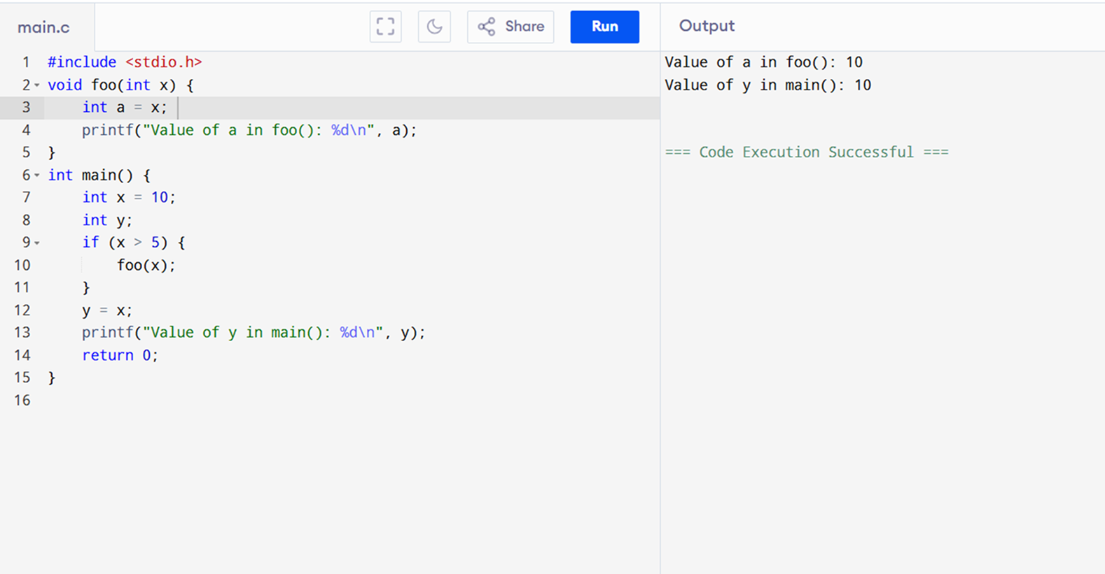
Implementation

Slide 9


Implementation Workflow & Methodology
Step 1: Convert source code into Control Flow Graph (CFG).
Step 2: Apply Pointer Analysis for data tracking.
Step 3: Use Graph Neural Networks (GNN) to analyze relationships.
Step 4: Detect security flaws or inefficiencies.
Step 5: Provide recommendations for optimization

Slide 10
Results & Performance Evaluation
Performance Metrics:
Accuracy: How well does the model detect data flow correctly?
Efficiency: Time taken to analyze a program.
Scalability: Ability to handle large-scale software.
Comparison with Existing Models:
Higher accuracy than traditional methods.
Faster processing with lower memory consumption.

Slide 11
Discussion on Efficiency & Accuracy
:Strengths of the Proposed Model:
Improved security analysis.
Handles recursion and dynamic function calls better.
Areas for Improvement:
Needs better optimization for extremely large codebases.
Requires more real-world validation on diverse datasets.

Slide 12
CHALLENGS AND LIMITATIONS
Technical Challenges:
Handling recursive function calls and dynamic memory allocation.
Ensuring context sensitivity without excessive computational overhead.
Dependency Management:
Managing dependencies across global variables and functions Current Constraints:
Limited support for certain language features (e.g., pointers in C).
Requires further optimization for real-time analysis in IDEs.
Future Needs:
Improved handling of dynamic memory allocation and pointers..

Slide 13
Future Scope
Integrate Machine Learning for Self-Learning
Model adapts and improves over time.
Extend Support for More Languages
Currently optimized for C/C++; need support for Python, Java, etc.
Reduce Computational Complexity
Work on minimizing execution time further Scope for Further Research
Automated Code Repair
Not just analysis, but also fixing vulnerabilities automatically.
Integration with IDEs
Real-time suggestions in VS Code, IntelliJ, etc.
More Real-World Testing
Apply to large-scale enterprise applications.

Slide 14
Extensions
"Extensions
Support for Other Languages:
Extend the tool to support C++, Java, and Python.
IDE Integration:
Integrate with popular IDEs (e.g., Visual Studio, Eclipse) for real-time analysis.

Slide 15
Conclusion
Summary:
Inter-procedural data flow analysis is a powerful technique for improving code quality and performance.
The proposed model addresses key limitations of existing tools and offers a scalable, context-sensitive solution.
Future Work:
Extend support for more languages and integrate with AI-driven tools

Slide 16
REFERENCES
IEEE Transactions on Software Engineering
Why it's useful: This journal publishes high-quality research on software engineering, including static analysis and data flow techniques. Look for papers on inter-procedural analysis.
ACM SIGPLAN Conference on Programming Language Design and Implementation (PLDI)
Why it's useful: PLDI is a top-tier conference where cutting-edge research on compiler design, including data flow analysis, is presented.
International Conference on Software Engineering (ICSE)
Why it's useful: ICSE is a premier conference for software engineering research, including static analysis and inter-procedural data flow analysis.

Slide 17
Queries & Discussion – Key Takeaways
Summary of ContributionsEnhanced Accuracy: Tracks inter-procedural dependencies more effectively.Better Performance: Reduces computation time and memory footprint.Supports Automated Code Refactoring: Helps developers write cleaner, optimized code

